Slide 1

1
CapStone Presentation
Quantum Cryptography for Secure IoT- Use quantum cryptographic methods to secure IoT networks.
Presented By:
Tanay Yaduka, 22070521086, Sem: 6th, Section: C
Shaikh Tauhid, 22070521087, Sem: 6th, Section: C
Abhishek Wekhande, 22070521113 Sem: 6th, Section: C

Slide 2

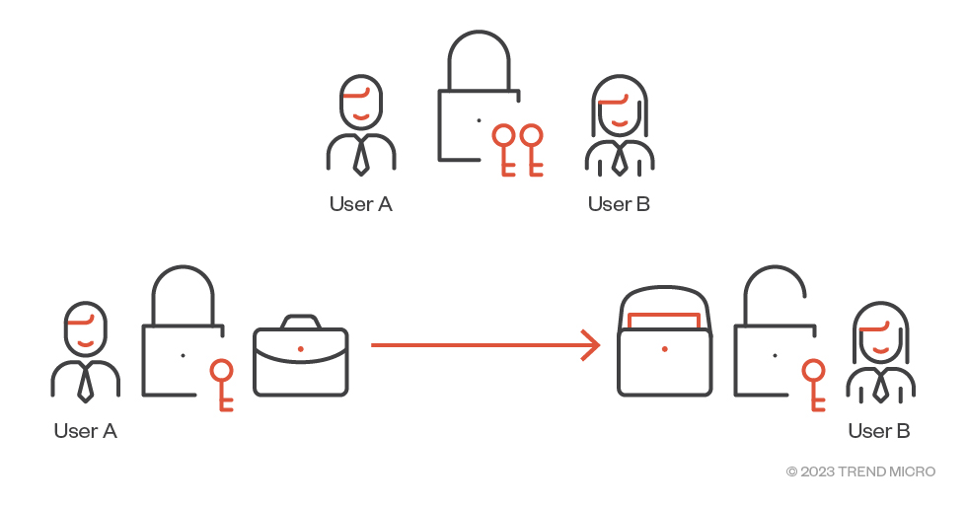
Introduction & Problem Statement
2
Problem Statement
The rise of IoT has led to billions of interconnected devices.
These devices share sensitive data and are vulnerable to cyberattacks.
Traditional encryption methods (RSA, ECC) may become obsolete due to quantum computing.
There's a need for quantum-resilient cryptographic systems.
“How can we ensure secure communication in IoT networks in the era of quantum computing?”

Slide 3
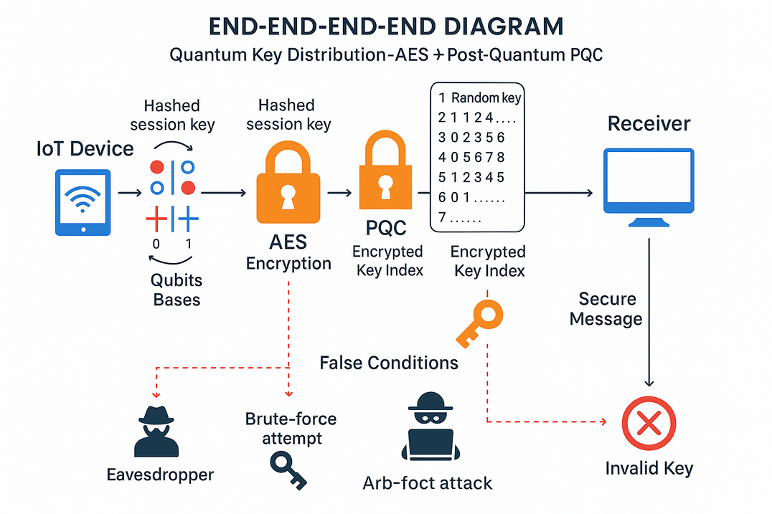
Objectives
3
✅ Implement Quantum Key Distribution (QKD) simulation using BB84 protocol.
✅ Secure key verification using index encryption.
✅ Use AES-GCM for message encryption and integrity.
✅ Develop a command-line secure chat interface.
✅ Ensure forward secrecy by destroying keys post-session.
✅ Demonstrate real-time secure communication.

Slide 4
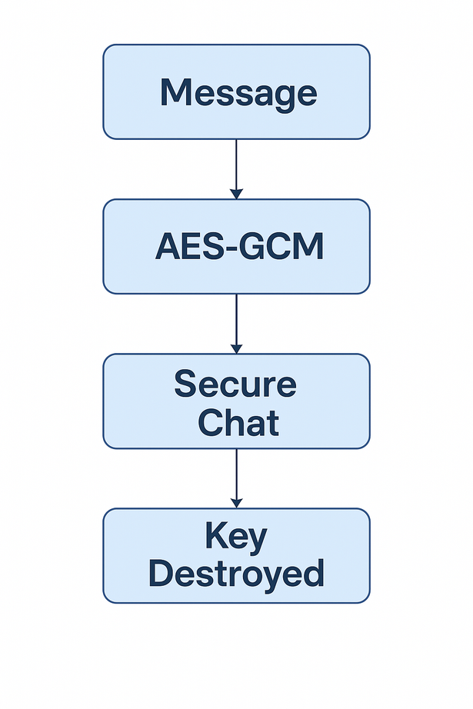
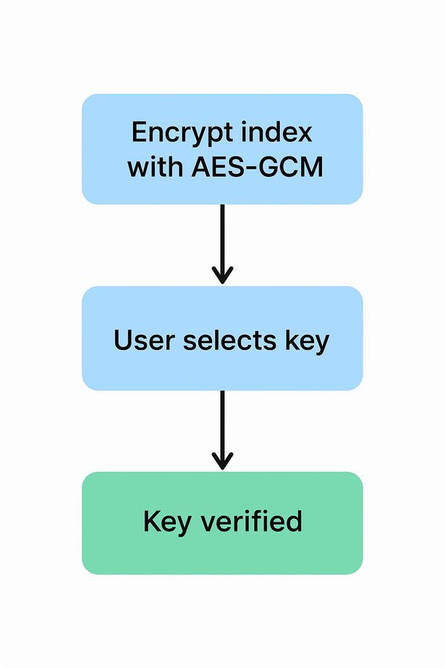
Methodology
3
BB84 QKD Simulation: Generation of random bits and bases, reconciliation of shared key.
Key Derivation with HKDF: SHA-256 used to expand quantum key into AES key.
Index Encryption: Shared index encrypted using AES-GCM for key validation.
Secure Chat Interface: Messages encrypted, validated, logged.
Forward Secrecy: Keys destroyed after limited messages (3–6).

Slide 5
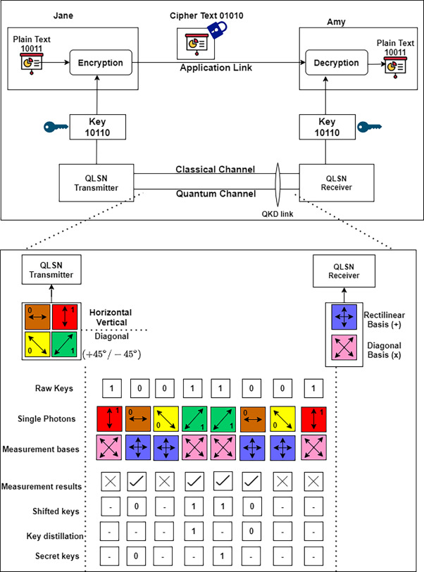
Results
3
BB84 simulation successfully creates shared keys.
AES-GCM provided confidentiality and integrity.
Session terminated securely on wrong key entry.
Logging captured all secure events.
Keys destroyed after limited cycles, ensuring forward secrecy.
Simulation mimics real IoT messaging in Python CLI.

Slide 6
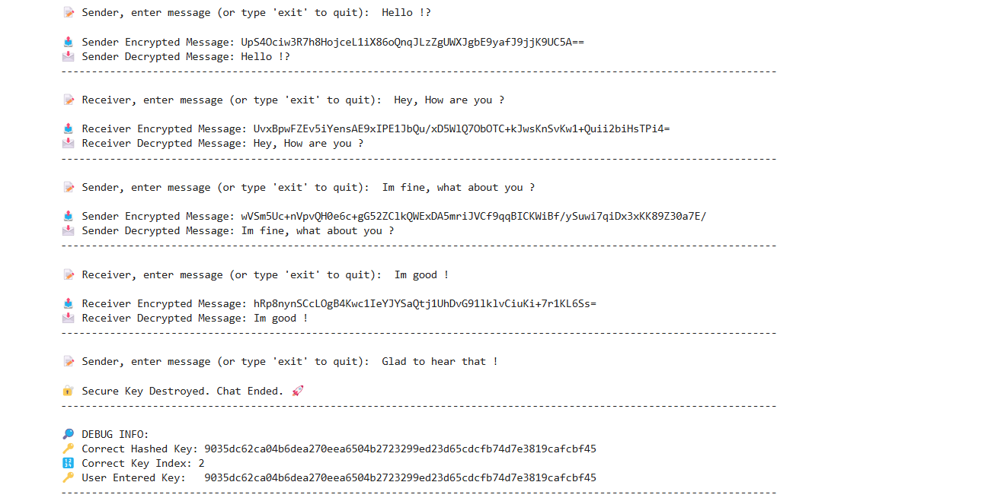
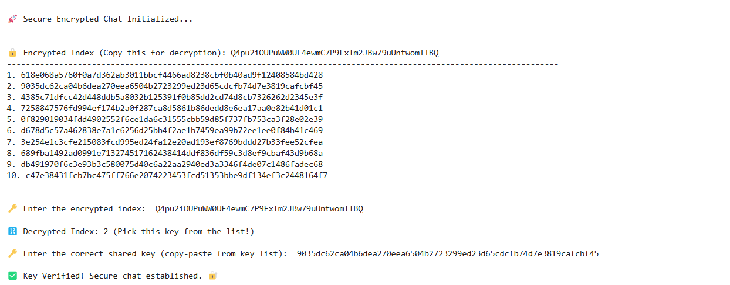
Results
3

Slide 7
3
Conclusion & Future Scope
Demonstrated quantum-safe communication using BB84 + AES-GCM.
Developed a functional secure chat model suitable for IoT environments.
Simulated real-time communication with full session control and secure logging.
Future Scope
Integrate Post-Quantum Cryptography (Kyber, Dilithium).
Use MQTT protocol for real IoT message transfer.
Create WebSocket-based live chat interface.
Build GUI for user-friendly secure communication.

Slide 8
3
References
Bennett, C. H., & Brassard, G. (1984).
Quantum Cryptography: Public Key Distribution and Coin Tossing.
Proceedings of the IEEE International Conference on Computers, Systems and
Signal Processing, Bangalore, India.
NIST (2023).
Post-Quantum Cryptography Standardization Project.
U.S. National Institute of Standards and Technology.
PyCryptodome Documentation.
Cryptographic Primitives for Python – AES-GCM Implementation.
RFC 5869 – HMAC-based Extract-and-Expand Key Derivation Function (HKDF).
MQTT.org.
MQTT: Lightweight Messaging Protocol for IoT.

Slide 9
1
THANK YOU

